Slide 1

Doge Pirates of the Cryptobbean
Matthew Newkirk, James Reeves, Blake Cizek and Abdullahi Said

Slide 2
Executive Summary
Learning Objectives:
Develop domain knowledge of cryptocurrency exchanges and machine learning expertise as it applies to developing algorithmic trading strategies
Project Objectives:
Develop an analytical framework which utilizes a multivariate regression to predict the closing price of Bitcoin (BTC), sourced from various exchange metrics
Wireframe a robo-advisor that will utilize derived price predictions and and social media sentiment to recommend the appropriate trading action & expand to other cryptocurrencies
Create the foundation for expanding to additional cryptocurrencies across exchanges
Summary:
Utilizing leads and lags at the day-grain, trained an LSTM with partial success which was able to predict BTC closing price with a Root Mean Squared Error of 5158 and R² of 0.79, struggling to scale with extreme volatility in the near term
Wireframed the foundations of a trading bot at 5 min intervals utilizing social media sentiment within about $192 dollars on average.

Slide 3
Technical Summary:
Data Preparation & Feature Engineering:
Domains:
Cryptocurrency Metrics (CoinMarketCap, Blockchain.com, Kraken/CCXT) from late 2013 to present day
OHLCV, Market Capitalization, Circulating Supply, Max Supply and calculated ratios
On-chain Indicators (GlassNode)
NUPL and MVRV Z-ratio
Social media sentiment metrics (Reddit & Twitter)** at 5 min intervals
VADER Scores
APIs:
Kraken/CCXT, GlassNode, Reddit, Blockchain.com, Twitter
Dataframe Grain:
Day-grain with 5, 1-day lags
Model Preparation & Training:
Framework tested both locally on Jupyter Lab and on Google Collab:
Tensorflow Recurrent Neural Nets (RNNs) via Keras API, utilizing Long Short-Term Memory (LSTM) layers
** Did not have sufficient data access to cover training timeframe for average social media sentiment scores at the Day grain.

Slide 4
Feature Engineering

Slide 5
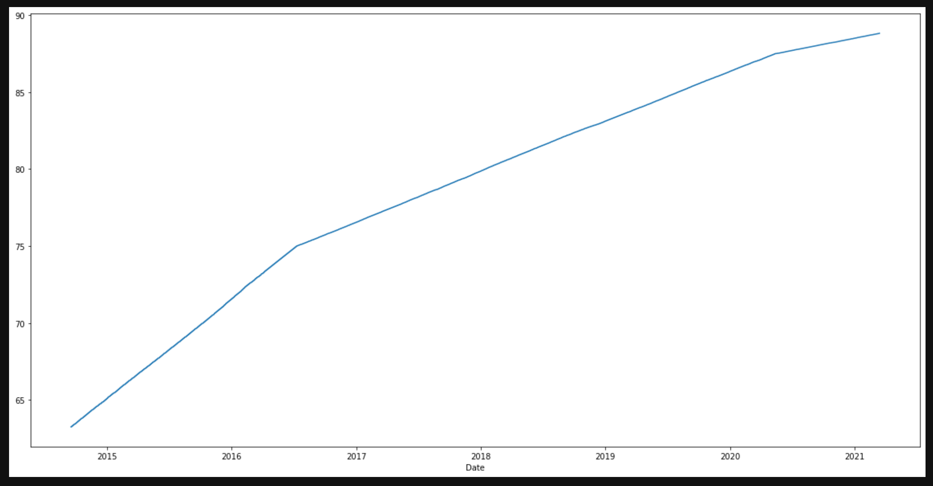
Cryptocurrency Basics
Bitcoin:
Circulating Supply - approximation of the number of coins or tokens that are circulating in the market and in the general public’s hands
Total supply - number of coins or tokens that have been mined minus all coins that have been burned
Max Supply - hard-coded limit that neither total nor circulating supply can ever exceed
21M BTC
Market Capitalization - total value of circulating supply time current market price
Supply Ratio - Circulating Supply / Max Supply
About 90% of bitcoin is in circulation
MarketCap Supply Ratio - MarketCap / Circulating Ratio
Circulating Supply Ratio of BTC

Slide 6
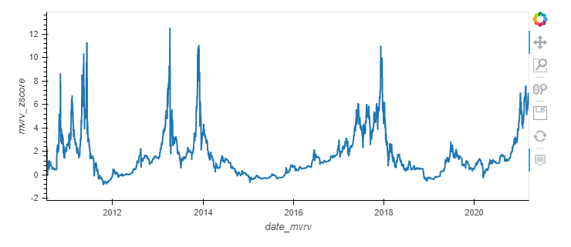
Bitcoin On-Chain Indicators
MVRV Z-Score:
Market Value Realized Value
Identifies when BTC is over or undervalued as compared to its “fair value” (which is the Realized Value)
Used to identify when Market Value is moving unusually above (or below) Realized Value
Score ranges from below 0 (market severely undervalued) to 7 or over (market severely overvalued)
Z-Score = Market Cap - Realized Cap
Standard Deviation (Market Cap)

Slide 7
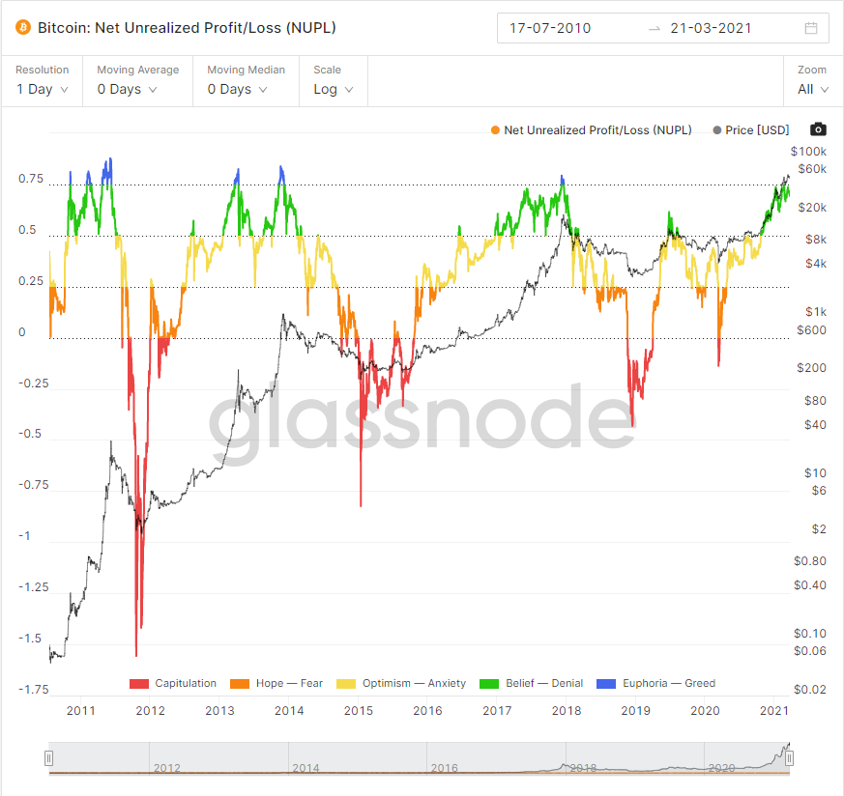
Bitcoin On-Chain Indicators
NUPL - Net Unrealized Profit or Loss:
Relationship between current price and realized price of BTC
Indicates how much of BTC’s circulating supply at any given point is in profit or loss and to what extent
Uses the UTXO (Unspent Transaction Outputs) structure to compare the BTC price at the current price and the price at the time a UTXO was created (last moved), i.e. the realized price
Incorporates:
The number of UTXOs in profit/loss
The Bitcoin supply in profit/loss
The unrealized profit/loss
NUPL is a long-term signal that indicates investor sentiment at various market cycle stages
Helps investors identify market tops and bottoms
Scores above .75 indicate over-valued, below 0 under-valued

Slide 8
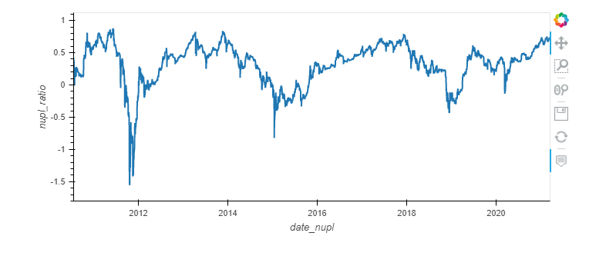

Slide 9
Model Engineering

Slide 10
LSTM Features & Parameters
Feature Set:
Volume, Circulating Supply, Supply Ratio, Volume Supply Ratio, MVRV Z-score, NUPL ratio, 5-day rolling volatility, and MarketCap, circulating supply ratio, and close price
5, 1-day lags cross referenced to one output lead, serving as the forecasted the next day’s closing price.
Train-test split set to 70%
Model Description
Tensorflow RNN
LSTM layers via Keras API
Model Specifications
1 input layer, 2 hidden Layers
Inputs lagged 5 days
Dropout rate of 20% per hidden layer.
1000 epochs,
28 batch size
Adam Optimizer
Notes:
Long Short-Term Memory (LSTM) is a type of recurrent neural network that can learn the order dependence between items in a sequence. LSTMs have the promise of being able to learn the context required to make predictions in time series forecasting problems, rather than having this context pre-specified and fixed.

Slide 11
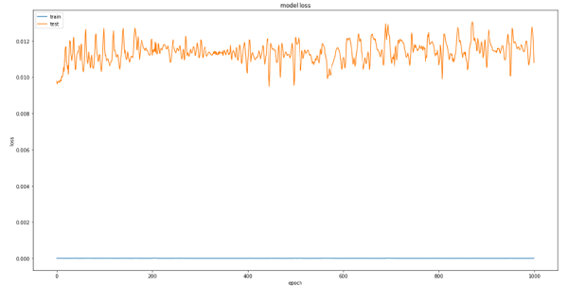
Model Evaluation/Results
Thus far the model has struggled to learn the rapid rise in BTC price towards the end of the dataset. Adding additional features such as rolling volatility and market supply cap ratio helped the model to grasp this sudden burst of value. Application of repeated fittings of varying batch sizes (finally settling upon a batch size of 7, or a week) also gradually helped the LSTM to ‘learn’ the price surge. Repeated fittings of training data also helped lower the the RMSE to 5158 with a R² of 0.79, and closing price at an average of $9000 dollars to around $5000. Additionally tweaking of both the feature set and model composition will likely lead to further improvements.
Notes:
The model is designed to consider the following features of BTC/USD data: Volume, Circulating Supply, Supply Ratio, Volume Supply Ratio, MVRV ratio, NUPL ratio, five day rolling volatility, and MarketCap supply ratio, and finally Closing price. The model receives these features as five inputted time lags cross referenced to one output time lag forecasting the next day’s closing price. The model implements a couple of dropout layers in-between hidden layers to prevent overfitting during the training process.

Slide 12
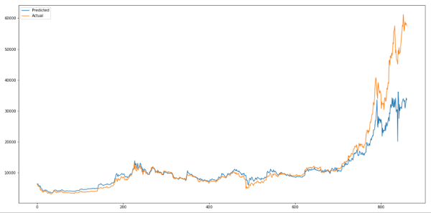
Model Conclusions
Though instructive as a learning exercise, formulating the machine learning forecast problem (whether or not the next day is a good day to trade BTC) as a regression problem is potentially a bad fit for the proposed usage of the model. Redefining the problem as classification would potentially be a better fit for the purpose of combining ML forecasting with other more traditional ALGO trade logic signals. Another recommendation could be to increase the training period to include recent price spikes.

Slide 13
Retrospective
Challenges:
Data availability of social media sentiment caused a riff between developing a model at the day grain and a trading bot to as low as 5 minutes, leading to an overcommitment on scope:
Deciding on the range for day grain and 5 minutes bot
Deciding on which features to add, not having enough time to check for highly correlated features, which could hurt the model
Last 6 months of extreme volatility caused issues for our feature limited dataset
Could have changed the training/ test split to include more recent price changes in the training.
Future Roadmap:
Devise working trade logic:
Signal Strategy Moving Average Crossover or MACD.
Integration of traditional ALGO trade strategy with LSTM online forecasting.
Once a specific trade strategy is postulated, it must be adequately backtested to evaluate the soundness and profitability of the proposed trading strategy.
Additionally, the working version of the automated script should incorporate live metrics to track the accuracy of the LSTM forecasting as new data occurs as well as tracking the potential profitability of the implemented strategy.
Develop a simulated trade environment to evaluate the bot without real financial risk.
Whether it be an existing Sandbox API (Like Coinbase) or a purely local simulation of price.

Slide 14
Five Minute Kraken Script
This script collects basic BTC ticker data every five minutes along with sentiment scores for recent posts about Bitcoin on both Twitter and r/Bitcoin.
It then fits data into a pre-trained LSTM with the same construction as used during our analysis. The LSTM then attempts to predict the next value for BTC’s closing price.

Slide 15
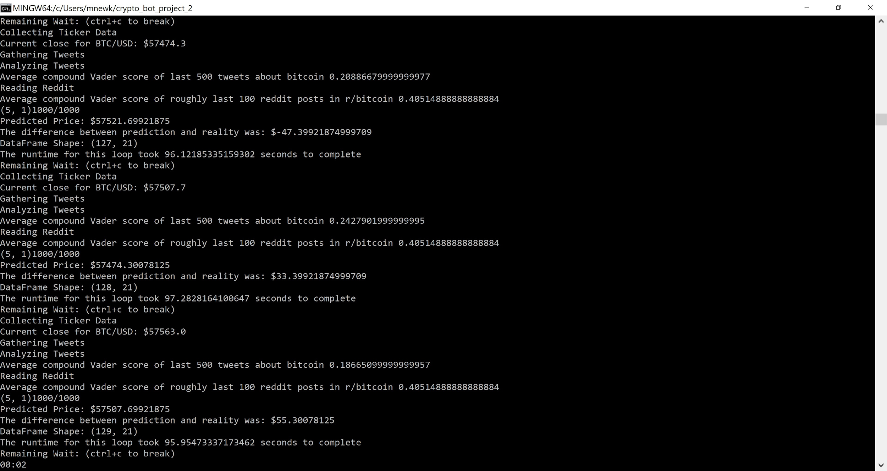

Slide 16


Questions?

